Slide 1



Strategic Insights and Performance Evaluation of Adventure Works
Presented by :
Amr Abdelraoof
Mohamed Ahmed Ragab
Mohamed Ahmed Saleh
Mostafa AbdlRazik

Slide 2




Overview
The purpose of this project is to conduct a comprehensive analysis of the various departments within Adventure Works, focusing on product performance, sales trends, human resources, and procurement efficiency. The aim is to identify key insights that can drive strategic decision-making, optimize operations, and enhance overall profitability.

Slide 3

Procurement
Product
Sales
Adventure Works
Departments
People
Human Resources

Slide 4
Questions To Answer Product:
Part 1: Product Performance Analysis
Which sub category products have the highest profit?
Which product categories are performing best?
What are the average sales per product per month?
Part 2: Inventory and Production Efficiency
Which products are at risk of stockouts?
How have the costs changed over time for each category?
How long does it take to complete a work order on average for each Category?
What is the scrap rate for each product Sub category?
Part 3: Market Demand and Trends
Which geographical locations have the highest product storage?
What is the percentage of discontinued products in each category?
How do costs compare against revenue for sub categories with high cost?

Slide 5
Questions To Answer Sales:
1. What is the total revenue generated from completed orders by order date?
2. Which products are generating the most revenue from completed orders?
3. How are sales distributed across different sales territories?
4. How has sales performance grown compared to previous years?
5. Which customers are contributing the most to the company's revenue over time?
6. What is the impact of special offers on sales revenue?

Slide 6
Questions To Answer People:
1- Which cities have the highest number of addresses?
2- What is the most person type by count of business entity ?
3- Which states have the most addresses?
4- What is the distribution of email promotion preferences?
5- What are the most common titles among individuals?

Slide 7
Questions To Answer HR:
HR and Employee Data:
1. Employee Demographics
a) What is the total number of employees in the organization?
b) What is the gender distribution of employees in each department?
2. Salary and Compensation
a) What is the average salary of employees in each department?
b) What is the average salary of employees in each job title?
3. Employee Tenure and Retention
a) What is the average tenure of employees in each department?
b) What is the average number of years of service for employees in each job title?
4. Time-off and Leave
a) What is the average number of vacation hours taken by employees in each department?
b) What is the average number of sick leave hours taken by employees in each department?
5. Job Titles and Roles
a) What is the average number of employees in each job title?
b) What is the average number of employees in each shift?

Slide 8
Questions To Answer HR:
Procurement and Supply Chain
1. Purchase Order Metrics
a) What is the total number of purchase orders placed in the last quarter?
b) What is the average total due for each purchase order?
2. Vendor Performance
a) Which vendor has the highest total due for all purchase orders?
b) What is the average number of days between order date and ship date for each vendor?
3. Product Metrics
a) What is the average number of products received per purchase order?
b) What is the average number of products rejected per purchase order?
4. Procurement Efficiency
a) What is the average number of employees in each department, and what is the average salary of those employees?
b) What is the average number of purchase orders placed by each employee, and what is the average total due for those orders?

Slide 9
Key Findings
Product Department Insights:
Top Profit Contributors: Touring, mountain, and road bikes are the highest profit generators, while components contribute less significantly to revenue.
Stockout Risks: Four products, including lower head races and women's tights, are at risk of stockouts and require inventory management attention.
Production Efficiency: The scrap rate is low (0.11% to 0.28%), indicating good production practices, while recent cost reduction efforts in component manufacturing have been effective.

Slide 10
Key Findings
2.Sales Department Insights:
Revenue Trends: Total revenue reached $123 million over the reviewed period, peaking in 2013 but declining significantly in 2014.
Key Products: The "Mountain-200 Black, 38" is identified as the highest revenue-generating product, contributing $4.5 million.
Sales Territories: The Southeast Territory stands out, generating $24.2 million in sales, highlighting geographic strengths.

Slide 11
Key Findings
3.Human Resources Insights:
Employee Composition: A total of 290 employees, with the Executive Department commanding the highest salaries ($68.30), while technical and production roles tend to have lower average salaries.
Tenure Metrics: Long tenures are noted in the Human Resources and Shipping departments (average ~15.75 years), suggesting stability in those areas.
Gender Distribution: The workforce displays a gender imbalance in technical roles, with a need to assess diversity strategies.

Slide 12
Key Findings
4.Procurement Insights
Purchase Orders: There were no purchase orders placed in the last quarter, warranting investigation into supply chain processes.
Supplier Reliability: Integrated Sport Products represents the highest total due for purchases, indicating key vendor relationships.
Delivery Timeliness: The average delivery time remains efficient at nine days, suggesting robust supply chain management.

Slide 13
Key Findings
5. Recommendations
Focus on Product Optimization: Increase marketing and sales efforts for less profitable categories and manage stock levels proactively to avoid future stockouts.
Enhance Sales Strategies: Investigate causes of revenue decline and create adaptive strategies to target high-performing territories further.
HR Strategy Review: Address diversity and inclusion, particularly in male-dominated departments, while evaluating salary structures for potential compression issues.
Procurement Review: Conduct a detailed review of procurement processes to understand the drop in purchase orders and assess supplier performance.

Slide 14


Data Modeling

Slide 15
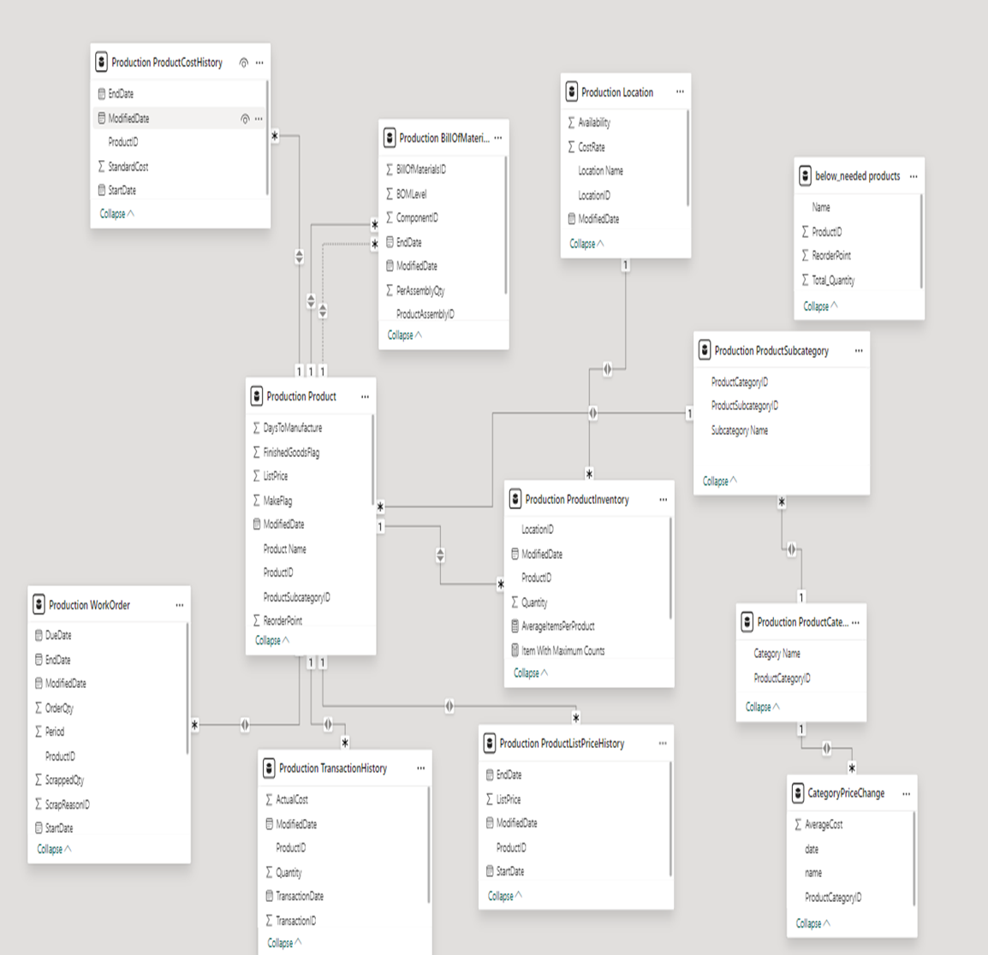
Production Data Modeling

Slide 16
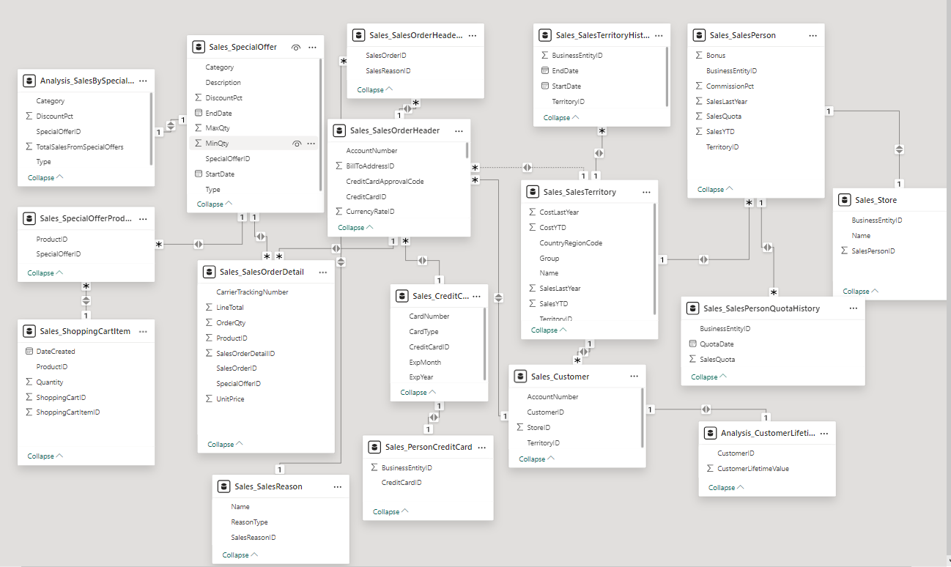
Sales Data Modeling

Slide 17
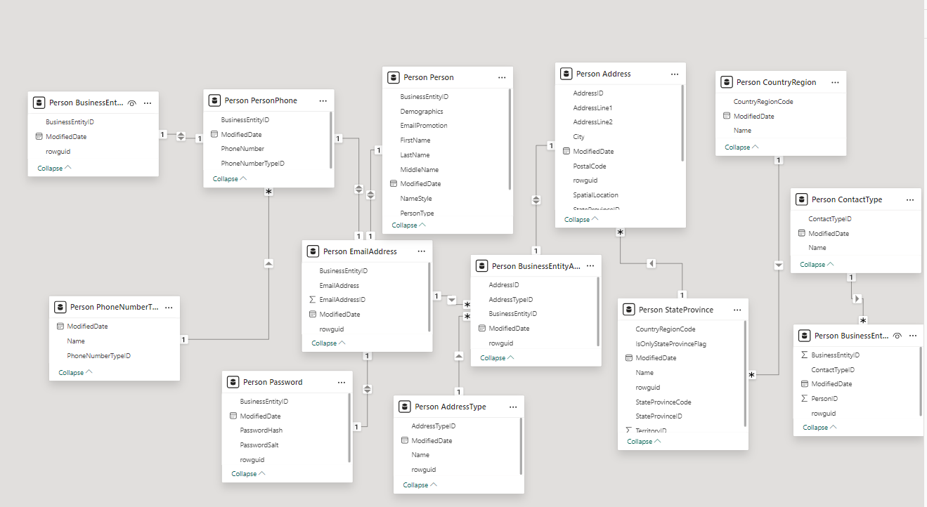
People Data Modeling

Slide 18
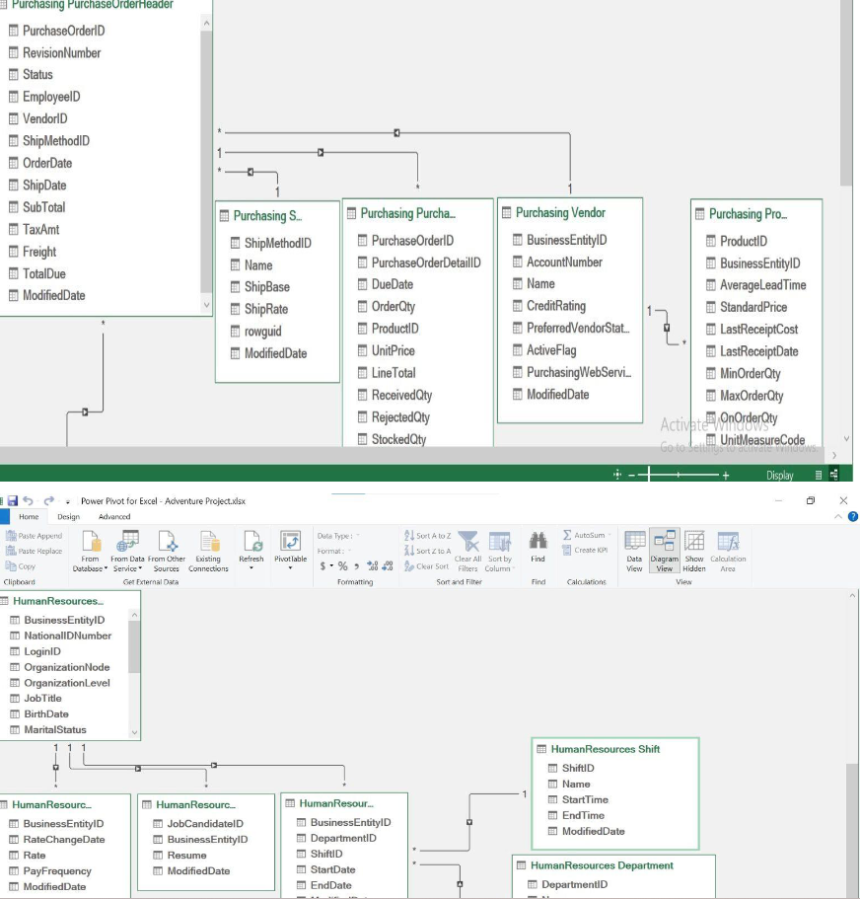
HR Data Modeling

Slide 19
Dashboards

Slide 20
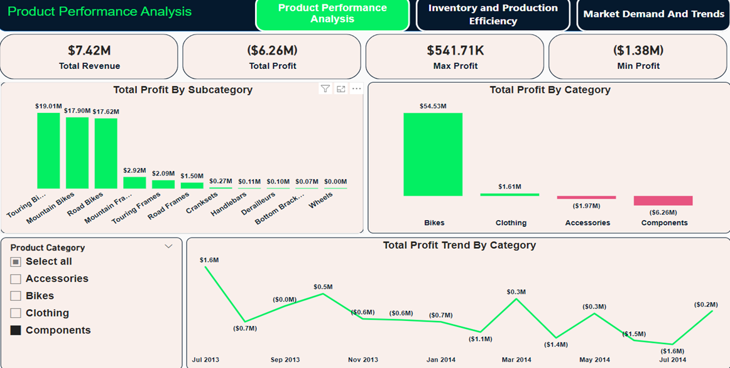
Product Performance

Slide 21
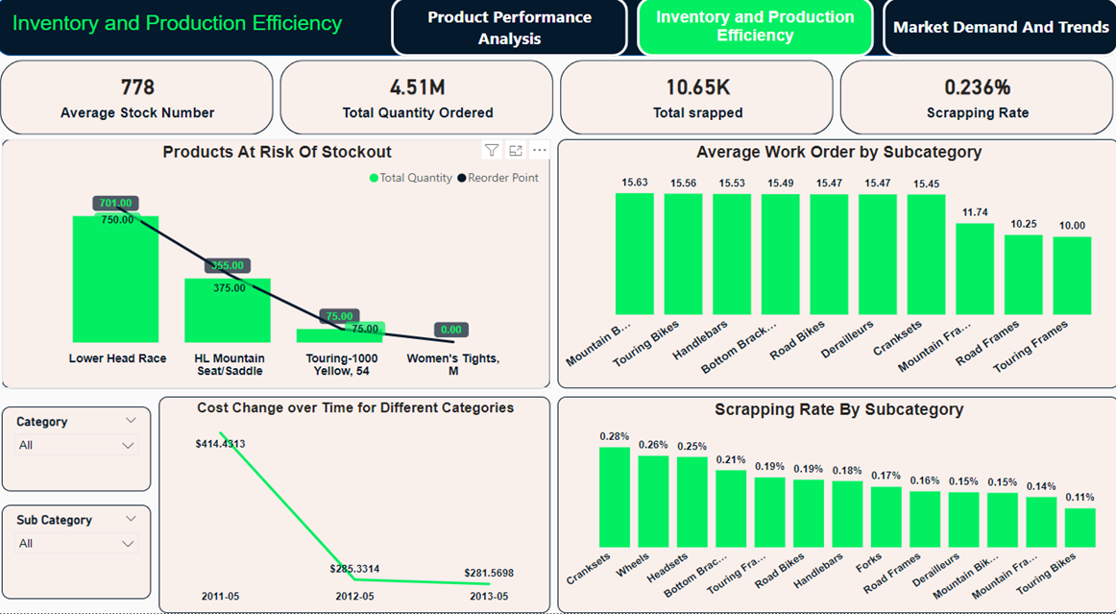
Inventory and Product Efficiency

Slide 22
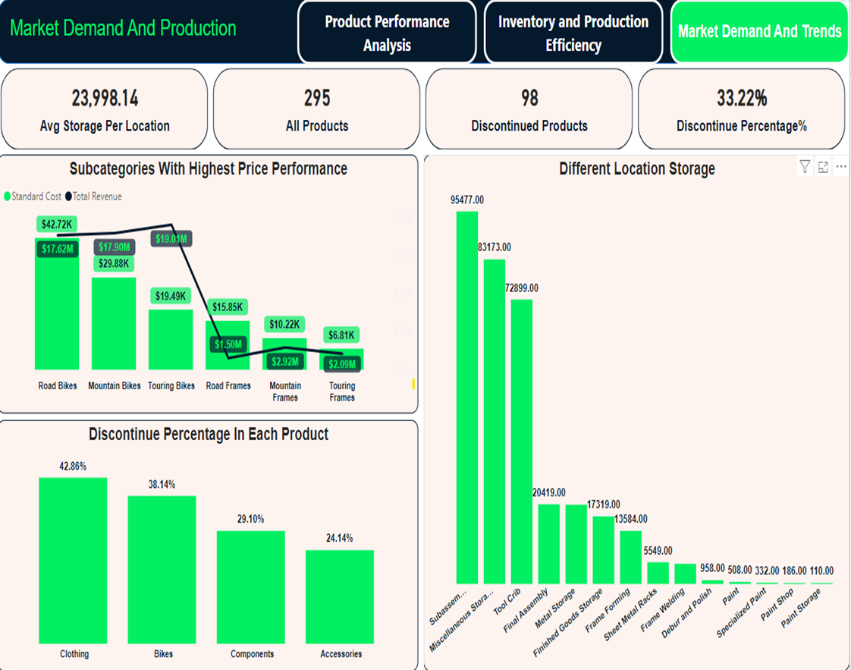
Market demand and Product

Slide 23
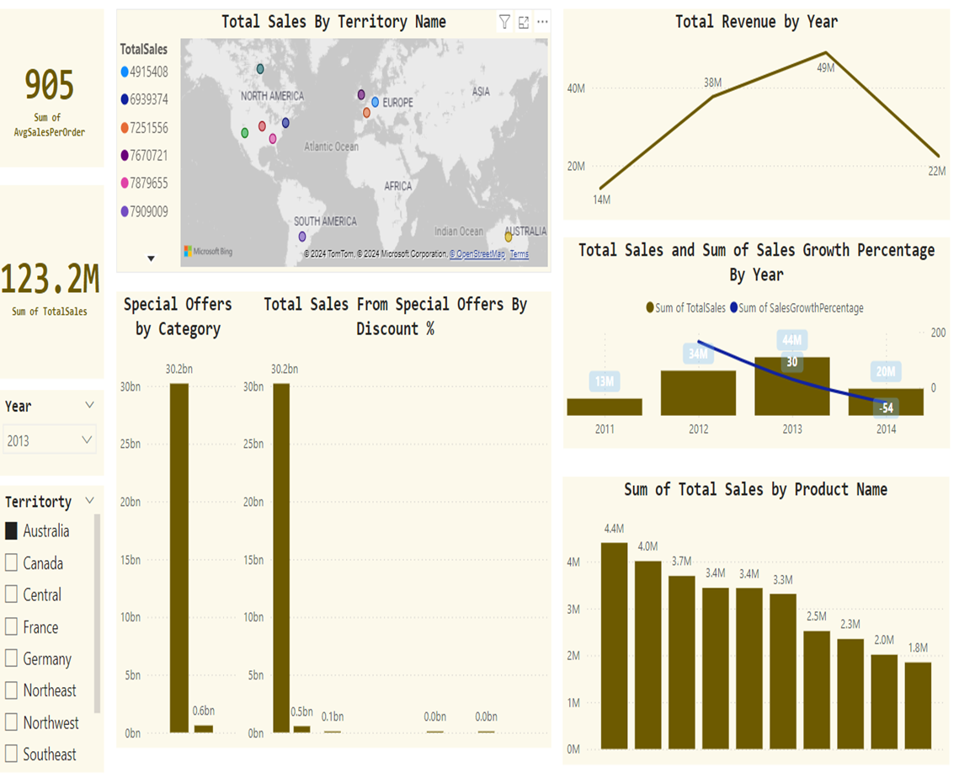
Sales Performance

Slide 24
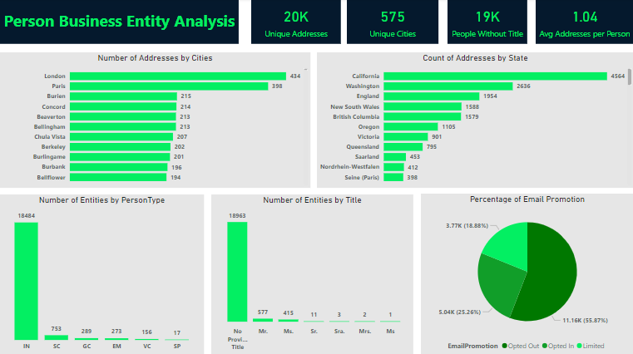
Person Analysis

Slide 25
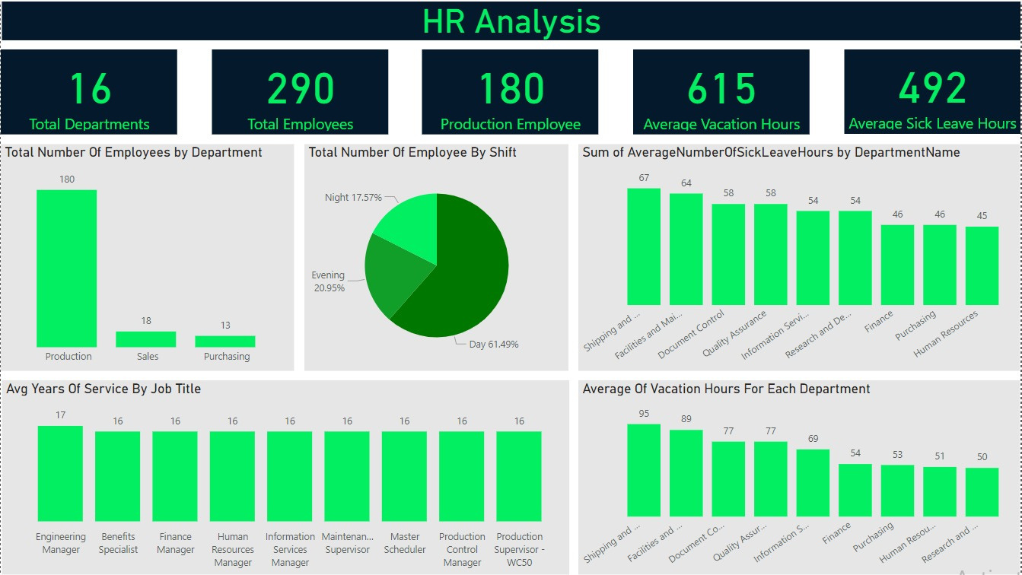
HR Analysis

Slide 26

Insights Conclusion
By integrating insights across departments and developing targeted strategies based on the data analysis, the company can improve overall productivity, foster employee engagement, and optimize financial performance. This holistic approach not only helps in addressing specific departmental needs but also contributes to the company’s ability to adapt to market dynamics and achieve sustainable growth.

Slide 27
Any Question ?!

Slide 28
THANK YOU
SO MUCH!

